Slide 1
Chapter Seven IP Addressing
Addressing is a key function of network layer protocols. Addressing enables data communicationbetween hosts on the same network or on different networks. Internet Protocol version4 (IPv4) provides hierarchical addressing for packets that carry your data.
IP Terminology
Bit: A bit is one digit, either a 1 or a 0.
Byte: A byte is 8 bits.
Octet: An octet, made up of 8 bits, is just an ordinary 8-bit binary number. In this chapter, the terms byte and octet are completely interchangeable.
Network address: This is the designation used in routing to send packets to a remote
network—for example, 10.0.0.0, 172.16.0.0, and 192.168.10.0.
An IP address consists of 32 bits of information. These bits are divided into four sections, referred to as octets or bytes, and four octets sum up to 32 bits (8×4=32). You can depict an IP address using one of three methods:
Dotted-decimal, as in 172.16.30.56
✓ Binary, as in 10101100.00010000.00011110.00111000
Hexadecimal, as in AC.10.1E.38
Binary-to-Decimal Conversion
Data represented in binary can represent many different forms of data to the human network. In this discussion, binary is discussed as it relates to IPv4 addressing. This means that each byte (octet) is interpreted as a decimal number in the range of 0 to 255.
For the decimal number 245, the 2 is in the 100s, or 10², position. Therefore, this 2 represents 2*10² (2 times 10 to the power of 2). Positional notation refers to this position as the base2 position because the base, or radix, is 10 and the power is 2. Using positional notation in the base 10 number system, 245 represents the following:
245 = (2 * 10²) + (4 * 10¹) + (5 * 10⁰)
Or
245 = (2 * 100) + (4 * 10) + (5 * 1)

Slide 2
In the binary numbering system, the radix is 2. Therefore, each position represents increasing powers of 2. In 8-bit binary numbers, the positions represent the quantities shown in Table shown below.
For the conversion of a 32-bit IPv4 address, you identify the 4 bytes or octets that make up this address. You then convert each of these four octets to decimal. As an example, convert the IPv4 address 10101100000100000000010000010100 to the bytes of a dotted decimal address. The conversion starts with the low-order bits, in this case byte 00010100, and continues up to the high-order byte.
Step 1:-Divide the 32 bits into 4 octets, as follows: 10101100.00010000.00000100.00010100 Step 2:- Convert the low-order byte 00010100 first, as seen in Table 1.
Step 3:- Convert the next-highest byte, which is 00000100, as seen in Table 2.
Step 4:- Continue converting with the next byte, 00010000, as seen in Table 3. Step 5:- Convert the highest byte, 10101100, as seen in Table 4.
Step 6:- Write down the four numbers with dots separating the octets, such as 172.16.4.20.
Table 1
Table 2

Slide 3
Table 3
Table 4
In this example, the binary number 10101100000100000000010000010100 is converted to 172.16.4.20. The address representation 172.16.4.20 is much easier for humans to interpret.
To make the conversion, you need to convert each octet individually. This process begins with the conversion of the most significant octet. The following describes the steps of the conversion of decimal 172, as shown in Figure 6-2.
Step1:- Because 172 is NOT less than 128, place a 1 in the 128 position and subtract 128 (1 * 128).
Step2:-Because 44 is less than 64, place a 0 in the 64 position and subtract 0 (0 * 64).
Step3:-Because 44 is NOT less than 32, place a 1 in the 32 position and subtract 32 (1 * 32).
Step4:- Because 12 is less than 16, place a 0 in the 16 position and subtract 0 (0 * 16).
Step5:- Because 12 is NOT less than 8, place a 1 in the 8 position and subtract 8 (1 * 8).
Step6:- Because 4 is NOT less than 4, place a 1 in the 4 position and subtract 4 (1 * 4).
Step7:- Because 0 is less than 2, place a 0 in the 2 position and subtract 0 (0 * 2).
Step8:- Because 0 is less than 1, place a 0 in the 1 position and subtract 0 (0 * 1).
Answer: 172 = 10101100
Homework:- convert the decimal numbers(16, 4, 20) to binary numbers.

Slide 4
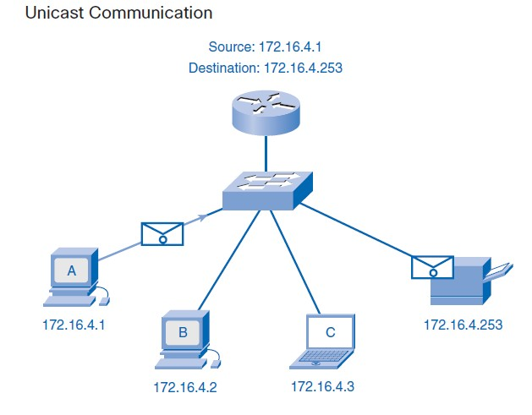
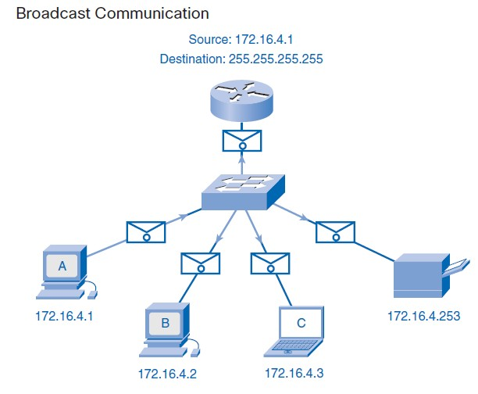
Addressing Types of Communication
1- Unicast: The process of sending a packet from one host to an individual host.
2- Broadcast: The process of sending a packet from one host to all hosts in the network.
3- Multicast: The process of sending a packet from one host to a selected group of hosts.

Slide 5
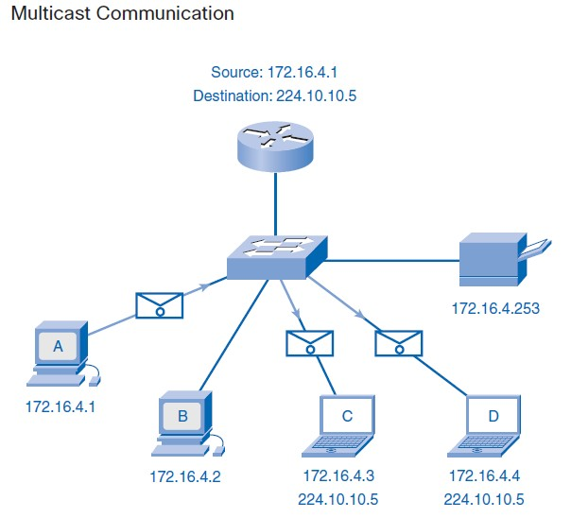
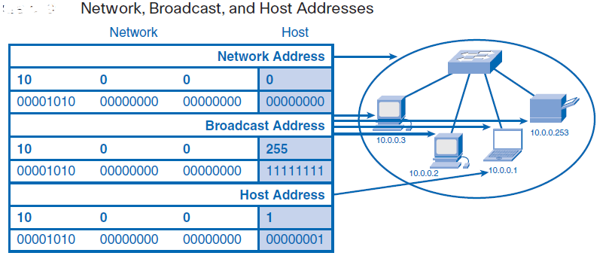
Types of Addresses in an IPv4 Network Range
Within each IPv4 network, there are three types of addresses:
Network address: A special address that refers to the network
Broadcast address: A special address used to send data to all hosts in the network
Host addresses: The unicast addresses assigned to the end devices in the network
Network addressing
The network address—also called the network number—uniquely identifies each network. Every machine on the same network shares that network address as part of its IP address. In the IP address 172.16.30.56, for example, 172.16 is the network address. Figure below summarizes the classes of networks

Slide 6
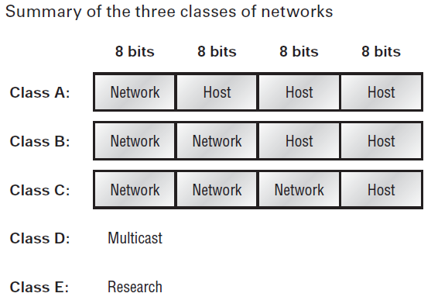
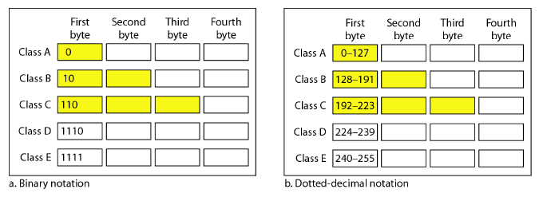
Class A Addresses
In a Class A network address, the first byte is assigned to the network address and the threeremaining bytes are used for the host addresses. The Class A format is as follows:
network.host.host.host
For example, in the IP address 49.22.102.70, the 49 is the network address and 22.102.70 is the host address. Every machine on this particular network would begin with the distinctive network address of 49.
Consider the following network address: 0xxxxxxx
If we turn the other 7 bits all off and then turn them all on, we’ll find the Class A range
ofnetwork addresses: 00000000 = 0
01111111 = 127
So, a Class A network is defined in the first octet between 0 and 127, and it can’t be lessor more.

Slide 7
Example:-Find the class of each address.
A- | 00000001 00001011 00001011 11101111
B- | 11000001 10000011 00011011 11111111
C- | 14.23.120.8
D- | 252.5.15.111
Solution
The first bit is 0. This is a class A address.
The first 2 bits are 1; the third bit is 0. This is a class Caddress. C- The first byte is 14; the class is A.
D- The first byteis 252 the class is E.
Class B Addresses
In a Class B network address, the first 2 bytes are assigned to the network address and theremaining 2 bytes are used for host addresses. The format is as follows:
network.network.host.host
For example, in the IP address 172.16.30.56, the network address is 172.16 and the hostaddress is 30.56.
Class C Addresses
The first 3 bytes of a Class C network address are dedicated to the network portion of theaddress, with only 1 measly byte remaining for the host address. Here’s the format:
network.network.network.host
Using the example IP address 192.168.100.102, the network address is 192.168.100 andthe host address is 102.In a Class C network address, the first three bit positions are always the binary 110. Thecalculation is as follows: 3 bytes, or 24 bits, minus 3 reserved positions leaves 21 positions.Hence, there are 221, or 2,097,152, possible Class C networks.
Class D and E Addresses
The addresses 224 to 255 are reserved for Class D and E networks. Class D (224–239)is used for multicast addresses and Class E (240–255) for scientific purposes. But they’rereally
beyond the scope of this book, so I’m not going to go into detail about them here. Butyou do need to know that the multicast range is from 224.0.0.0 through239.255.255.255.

Slide 8
Notes:-
1- Default masks for classful addressing

